Slide 1
Getting Started With
R Users Group – Macquarie University

Slide 2
What is ?
“R” is a programming language primarily used for statistical analysis and graphics
Allows you to easily create programable scripts to analyse data in a way that is reproduceable

Slide 3
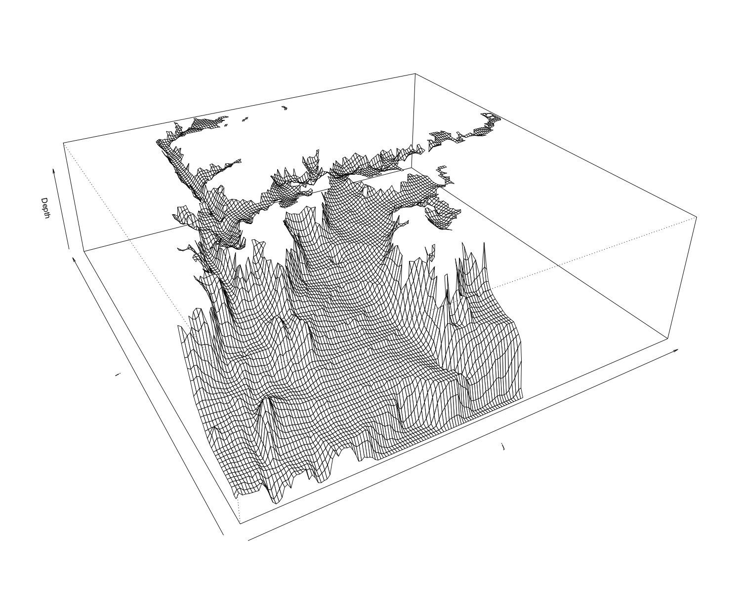
Use cases of
”R” can be used in limitless ways. Some examples:
Data analysis and statistics
Signal processing
Weather forecasting
Data graphics
Web scraping
Analysis of animal movement

Slide 4
Easy to learn!
Link to tutorial code: https://github.com/mqRusers
Go to link
Download as Zip file
Extract zip archive
Move the folder to the location you wish to work from (I recommend having a separate repository for each project you use R for)

Slide 5
This tutorial uses ”R-Studio”
“R-Studio” is an “interpreter” or “integrated development environment” (IDE) that makes it easier to write and execute R scripts.
”R-Studio” IS NOT “R” but an interface for using “R”. You need to install ”R” and ”R-Studio” separately.
If you need help please put up a red sticky note and an R-Users Group member will come and assist you.
Links:
https://www.r-project.org/
https://www.rstudio.com/
≠

Slide 6
Tutorial goals
First section – R Introduction (Lachlan)
Part 1 – Get you familiar with R studio and R’s syntax
Part 2 – Introduce some more advanced data structures
Part 3 – Apply what we’ve learned to a more advanced example
Second section – Tidyverse (Rodrigo)
Introduce you to some more advanced and/or alternative data processing functions using the Tidyverse package
Let’s get started!

Slide 7
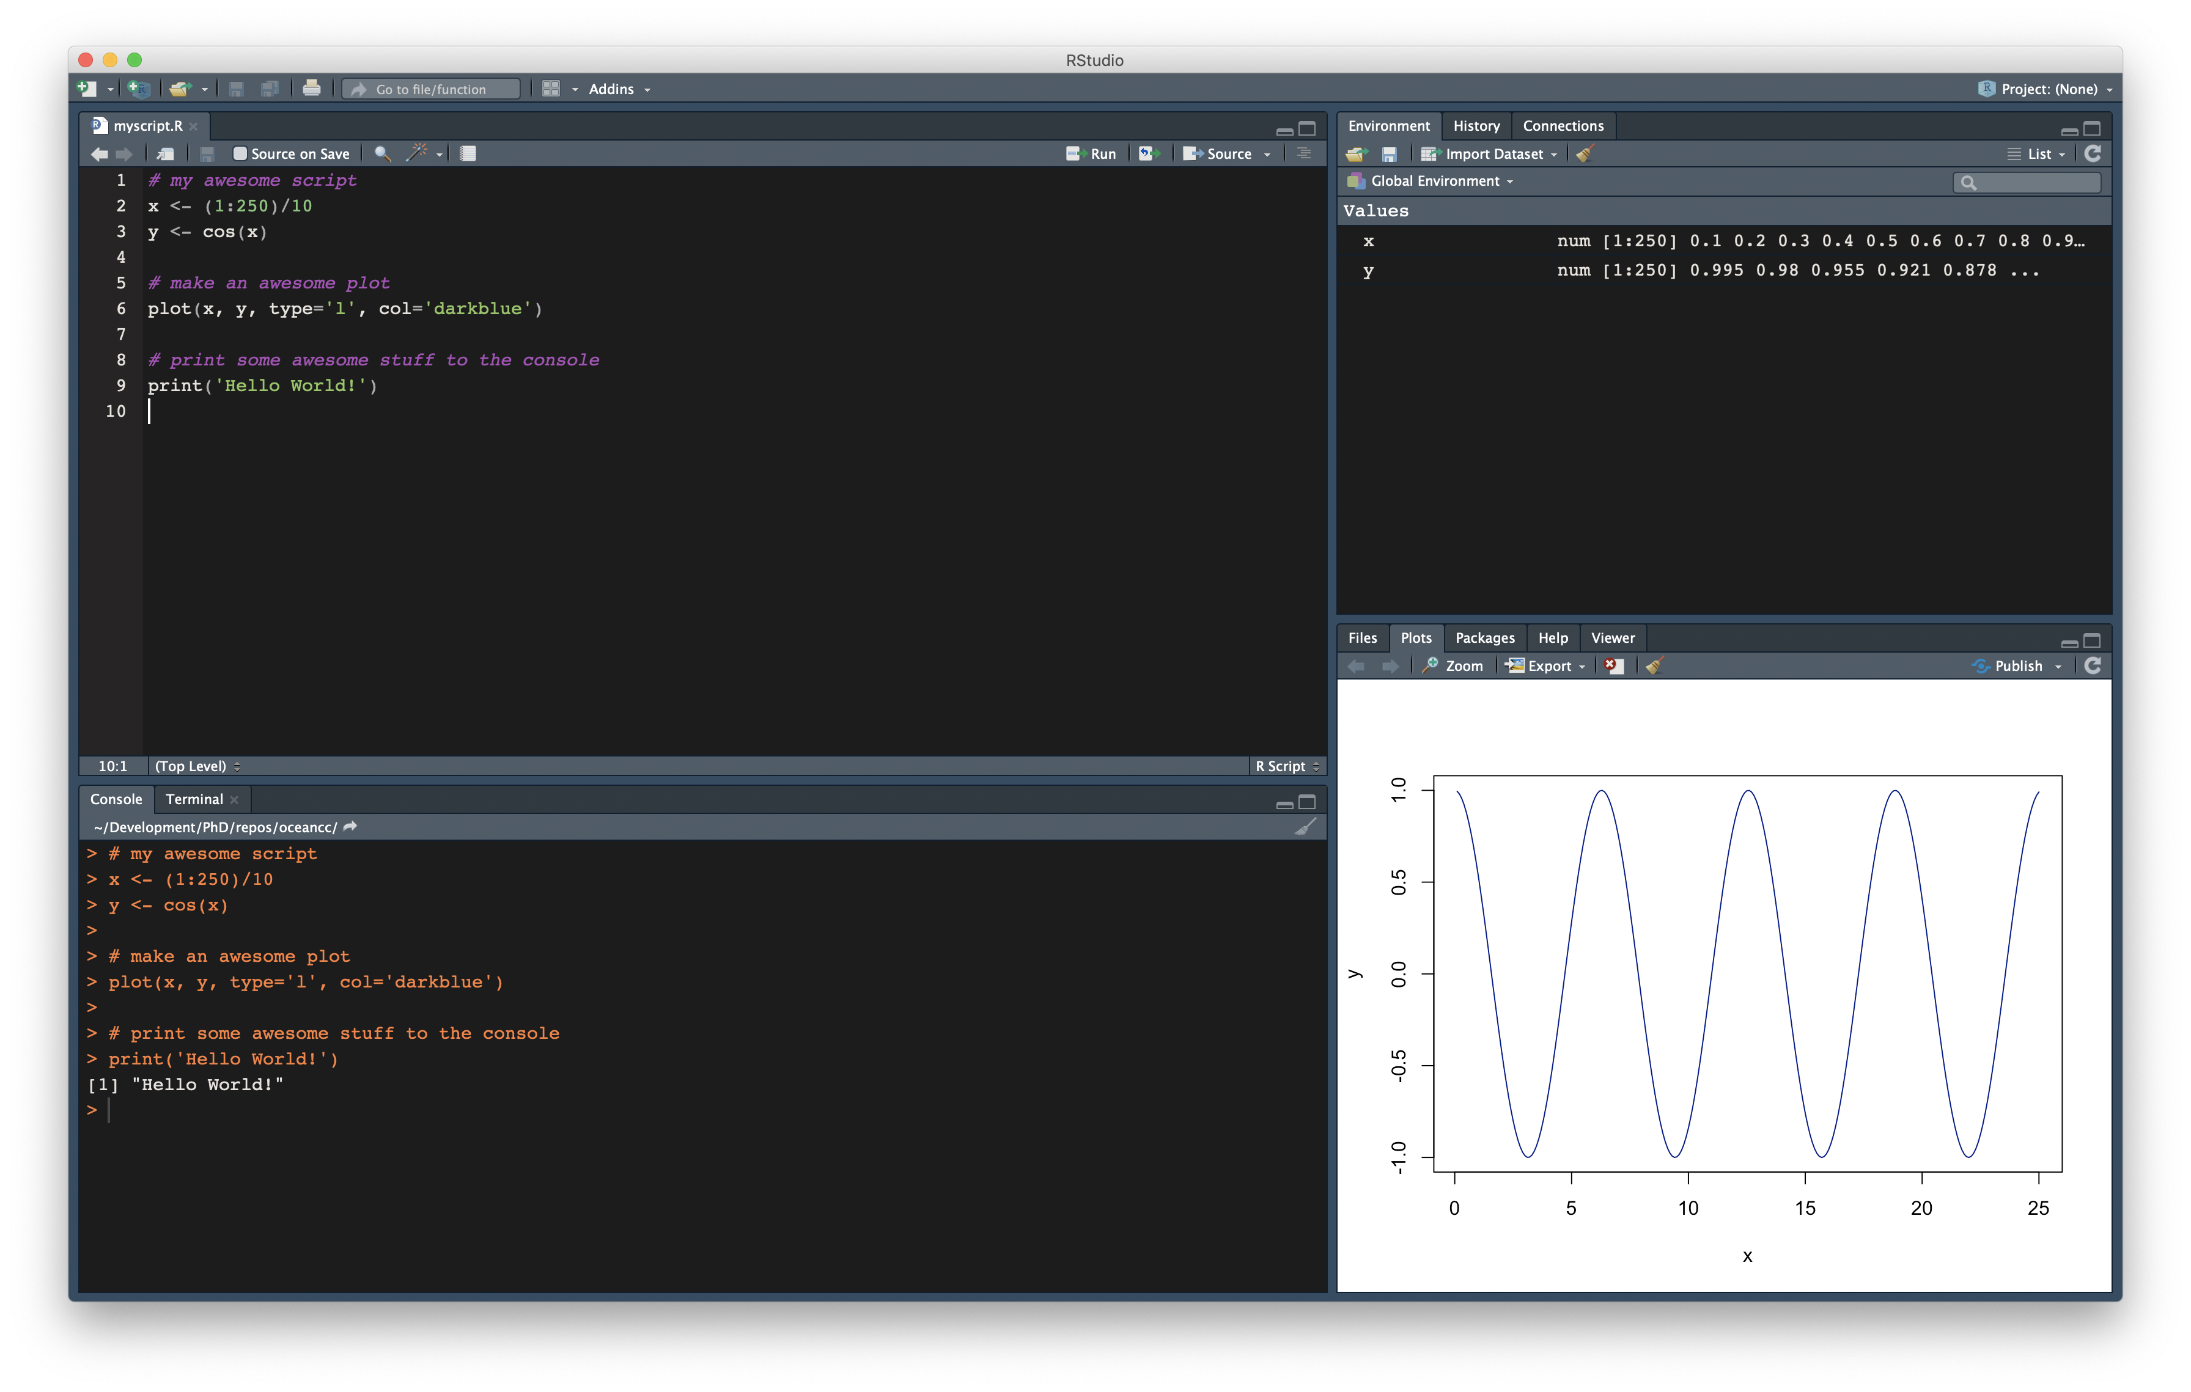
1. Editor
3. Environment
4. Plots, packages and files
2. Console

